Slide 1

CSCI 466: Networks
Lecture 1: Introduction, Syllabus, and Logistics
Reese Pearsall
Fall 2022
https://www.cs.montana.edu/pearsall/classes/fall2022/466/main.html

Slide 2


Communication in the Digital Era

Slide 3

Communication in the Digital Era

Slide 4


Communication in the Digital Era
“Hello, John!”

Slide 5


Communication in the Digital Era

Slide 6

Communication in the Digital Era

Slide 7





Communication in the Digital Era

Slide 8



Communication in the Digital Era

Slide 9







Communication in the Digital Era

Slide 10
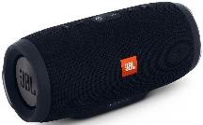







Communication in the Digital Era

Slide 11

Communication in the Digital Era

Slide 12
Communication in the Digital Era

Slide 13


Communication in the Digital Era

Slide 14

Communication in the Digital Era

Slide 15
Communication in the Digital Era
We have billions of devices that are constantly communicating with one another
306.4 billion emails are sent every day
There were 4.66 billion active internet users around the world in January 2021
Facebook generated four petabytes of data every day in 2020.
https://techjury.net/blog/how-much-data-is-created-every-day/#gref

Slide 16
Communication in the Digital Era

Slide 17
Communication in the Digital Era
???

Slide 18

Communication in the Digital Era
The Internet

Slide 19
Communication in the Digital Era
How does computer A send a message to computer B?
The Internet

Slide 20
Communication in the Digital Era
How does computer A send a message to computer B?
The Internet
There are layers or steps that describe the process for communicating over a computer network

Slide 21
Communication in the Digital Era
What are the different ways to design a computer network?
The Internet

Slide 22
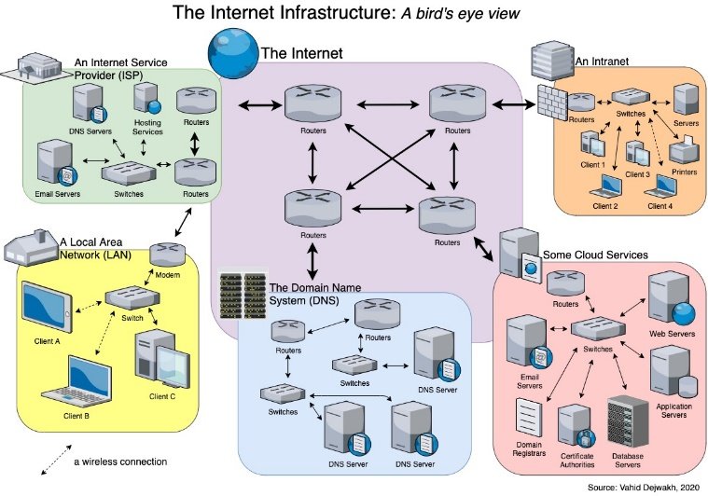
Communication in the Digital Era
What are the different ways to design a computer network?
The Internet

Slide 23
Communication in the Digital Era
What are the rules and protocols for communicating over a network?
The Internet

Slide 24
Communication in the Digital Era
What are the rules and protocols for communicating over a network?
The Internet
HTTP
UDP
TCP
SMTP
DNS
SSH
FTP

Slide 25
Communication in the Digital Era
How can we measure the performance or efficiency of a network?
The Internet

Slide 26
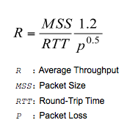
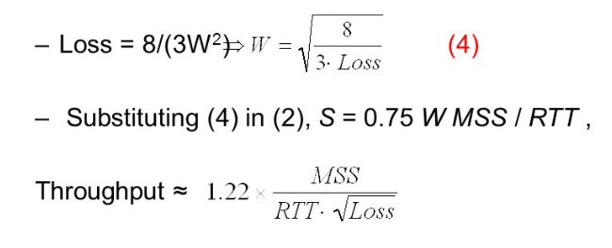
Communication in the Digital Era
How can we measure the performance or efficiency of a network?
The Internet

Slide 27



Communication in the Digital Era
How can we make our communications safe and trustworthy?
The Internet

Slide 28

CSCI 466- Course Outcomes
List the network layers and explain their function in end-to-end communications
Explain different network architectures and tradeoffs in the design decisions
Explain the functions of various Network protocols (HTTP, DNS, TCP/IP, FTP, etc)
Design and implement network application
Analyze network traffic
Measure network performance
Explore security issues in networks and understand important defense mechanisms

Slide 29
About Me

Slide 30
My Experience

Slide 31
Contact

Slide 32
Logistics

Slide 33
Prerequisites

Slide 34

Schedule

Slide 35
Course Questionnaire

Slide 36
Textbook

Slide 37
Grading

Slide 38
Grading Breakdown

Slide 39
Late Assignment Policy

Slide 40
Grading Scale

Slide 41
Plagiarism and Academic Misconduct

Slide 42
MSU Resources

Slide 43

How to do well in this class

